Slide 1
Operating Systems CPU Scheduling
4-6.12-16.15.18-47.53.55-56
Fagui Liu

Slide 2
Content of this lecture
Review
Why Scheduling?
Scheduling Levels
Scheduling in Batch systems
Scheduling in Interactive systems
Scheduling in Real time
Policy versus Mechanism
Thread Scheduling
Summary

Slide 3
Quick Quiz
What is process?
What’s in a process?
What’s in a PCB (Process control block ) of the process?
What’s process state?
What is a thread?
What’s difference between process and thread?

Slide 4
Process Review
So What Is A Process?
It’s one executing instance of a “program”
It’s separate from other instances
It can start (“launch”) other processes
It can be launched by them
What’s in a process?
Code (text), data, stack, heap
Process control block
Process state, priority, accounting
Program counter, register variables, stack pointers, etc
Open files and devices

Slide 5
Process State
Running
4
Terminated
1
2
3
Blocked
Ready
5
Suspend
activate
activate
Suspend
Suspended Ready
5’
Suspended Blocked
New

Slide 6
Threads: Lightweight Processes
A thread is a single execution
Stack
Program counters
Registers
All threads in a process share resources
Address space
Text, data, heap
Open files, etc
Implementations of threads
User-level, kernel-level, Hybrid, Service activation（激活）, pop-up

Slide 7
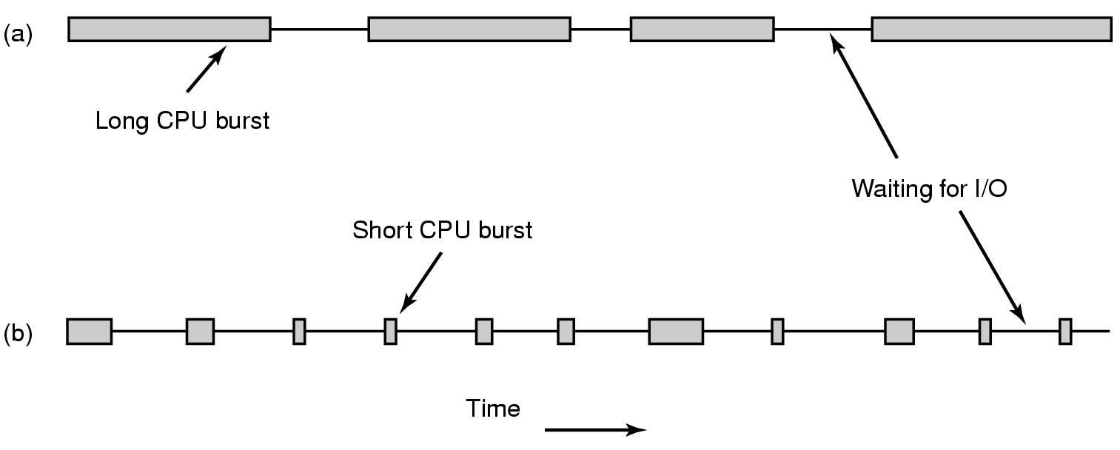
Scheduling – Process Behavior
Figure 2-38. Bursts of CPU usage alternate with periods of waiting for I/O. (a) A CPU-bound process. (b) An I/O-bound process.

Slide 8
When to schedule?
A new process starts
The running process exits（进入terminated）
The running process is blocked （进入blocked）
I/O interrupt (some processes will be ready)
Clock interrupt (every 10 milliseconds(毫秒))
（进入ready）

Slide 9
Preemptive(抢占) vs. Non-preemptive
Non-preemptive scheduling:
The running process keeps the CPU until it voluntarily gives up the CPU
process exits
switches to blocked state
1and 4 only (no 3)
Preemptive scheduling:
The running process can be interrupted and must release the CPU (can be forced to give up CPU)
Running
4
Terminated
3
1
Ready
Blocked

Slide 10
Categories of Scheduling Algorithms
Batch
Interactive
Real time

Slide 11
Scheduling Objectives
Fair (nobody cries)
Priority (lady first)
Efficiency (make best use of equipment)
Encourage good behavior (good boy/girl)
Support heavy loads (degrade gracefully)
Adapt to different environments (interactive, real-time, multi-media)

Slide 12
Performance Criteria
Fairness
Efficiency: keep resources as busy as possible
Throughput: # of processes that completes in unit time
Turnaround Time (also called elapse time)
amount of time to execute a particular process from the time its entered
Waiting Time
amount of time process has been waiting in ready queue
Response Time
amount of time from when a request was first submitted until first response is produced.
predictability and variance
Policy Enforcement:
seeing that stated policy is carried out
Proportionality:
meet users' expectation
Meeting Deadlines: avoid losing data

Slide 13
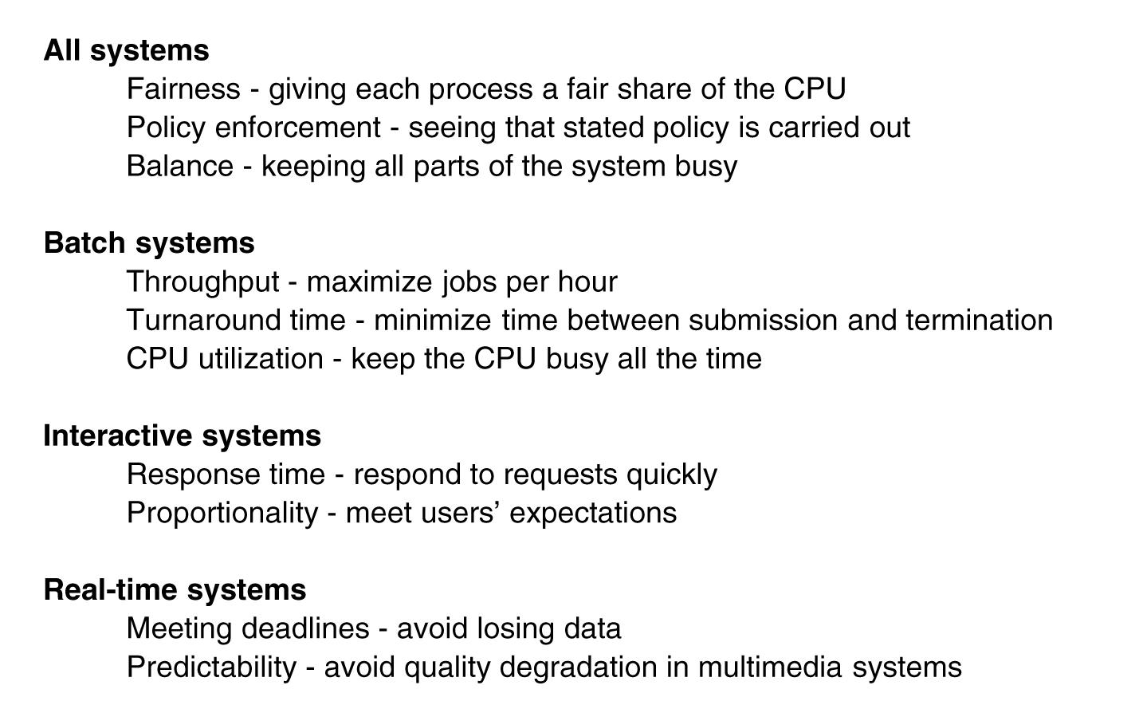
Scheduling Algorithm Goals
Different Systems, Different Focuses

Slide 14
Program Behaviors Considered in Scheduling
Is it I/O bound? Example?
Is it CPU bound? Example?
Batch or interactive environment
Urgency (紧急情况)
Priority
Frequency of page faults
Frequency of preemption
How much execution time it has already received
How much execution time it needs to complete
I/O
I/O
I/O
compute
compute

Slide 15
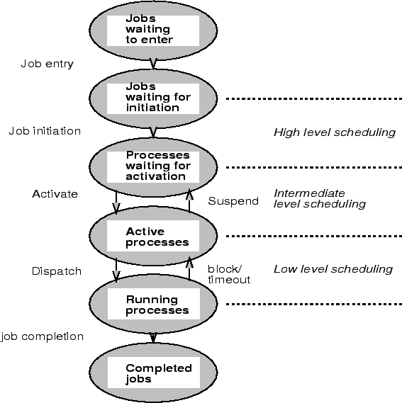
Scheduling Level
Which jobs should be allowed to compete for the CPU and other resources
Which jobs to temporarily suspend or resume to smooth fluctuations in system load.
Assigning a CPU to a ready process.

Slide 16
CPU Scheduler
Proc 1: 14 time units
Proc2: 8 time units
Proc3: 8 time units
Dispatcher
Preemptive vs. non-preemptive
CPU
Dispatcher
Proc 1
Proc 10
Proc 2
Proc 11
Proc 3
Proc 12
Ready queue
blocked queue

Slide 17
Dispatcher
Gives the control of the CPU to the process, scheduled by the short-term scheduler.
Functions:
switching context
switching to user mode
jumping to the proper location in the user program.
Dispatch Latency（调度延迟） :time to stop process and start another one.
Pure overhead
Needs to be fast

Slide 18
Single Processor Scheduling Algorithms
Batch systems
First Come First Serve (FCFS)
Short Job First
Shortest remaining Time next
Interactive Systems
Round Robin
Priority Scheduling
Multi Queue & Multi-level Feedback
Shortest process time
Guaranteed Scheduling（保证调度）
Lottery Scheduling(彩票调度）
Fair Sharing Scheduling

Slide 19
First Come First Serve (FCFS)
Process that requests the CPU FIRST is allocated the CPU FIRST.
Also called FIFO
Non-preemptive
Used in Batch Systems
Real life analogy: Fast food restaurant
Implementation: FIFO queues
A new process enters the tail of the queue
The schedule selects from the head of the queue.
Performance Metric: Average Waiting Time.
Given Parameters:
Burst Time (in ms), Arrival Time and Order

Slide 20
FCFS Example
Process | Duration | Order | Arrival Time
P1 | 24 | 1 | 0
P2 | 3 | 2 | 0
P3 | 4 | 3 | 0
The final schedule:
P1 (24)
P2 (3)
P3 (4)
0
24
27
P1 waiting time: 0
P2 waiting time: 24
P3 waiting time: 27
The average waiting time: (0+24+27)/3 = 17

Slide 21
Problems with FCFS
Non-preemptive
Not optimal AWT
Cannot utilize resources in parallel:
Assume 1 process CPU bounded and many I/O bounded processes
result: Convoy effect, low CPU and I/O Device utilization
Why?

Slide 22
Why Convoy Effects(护航效应）?
Consider n-1 jobs in system that are I/O bound and 1 job that is CPU bound.
I/O bound jobs pass quickly through the ready queue and suspend themselves waiting for I/O.
CPU bound job arrives at head of queue and executes until complete.
I/O bound jobs rejoin ready queue and wait for CPU bound job to complete.
I/O devices idle until CPU bound job completes.
When CPU bound job complete, other processes rush to wait on I/O again.
CPU becomes idle.

Slide 23
Shortest Job First (SJF)
Schedule the job with the shortest elapse time first
Scheduling in Batch Systems
Two types:
Non-preemptive
Preemptive
Requirement: the elapse time needs to know in advance
Optimal if all the jobs are available simultaneously (provable)
Gives the best possible AWT (average waiting time)

Slide 24
Non-preemptive SJF: Example
Process | Duration | Order | Arrival Time
P1 | 6 | 1 | 0
P2 | 8 | 2 | 0
P3 | 7 | 3 | 0
P4 | 3 | 4 | 0
P4 (3)
P1 (6)
P3 (7)
P2 (8)
0
3
9
16
24
P4 waiting time: 0
P1 waiting time: 3
P3 waiting time: 9
P2 waiting time: 16
The total time is: 24
The average waiting time (AWT): (0+3+9+16)/4 = 7

Slide 25
Comparing to FCFS
Process | Duration | Order | Arrival Time
P1 | 6 | 1 | 0
P2 | 8 | 2 | 0
P3 | 7 | 3 | 0
P4 | 3 | 4 | 0
P1 (6)
P2 (8)
P3 (7)
P4 (3)
0
6
14
21
24
The total time is the same.
The average waiting time (AWT): (0+6+14+21)/4 = 10.25
(comparing to 7)
P1 waiting time: 0
P2 waiting time: 6
P3 waiting time: 14
P4 waiting time: 21

Slide 26
SJF is not always optimal
Is SJF optimal if all the jobs are not available simultaneously?
Process | Duration | Order | Arrival Time
P1 | 10 | 1 | 0
P2 | 2 | 2 | 2
P1 (10)
P2 (2)
0
2 (p2 arrives)
10
12
The average waiting time (AWT): (0+8)/2 = 4
P1 waiting time: 0
P2 waiting time: 8

Slide 27
What if the scheduler waits for 2 time units? (Do it yourself)
Process | Duration | Order | Arrival Time
P1 | 10 | 1 | 0
P2 | 2 | 2 | 2
P2 (2)
P1 (10)
0
2
4
14
The average waiting time (AWT): (0+4)/2 = 2
However: waste 2 time units of CPU
P1 waiting time: 4
P2 waiting time: 0

Slide 28
Preemptive SJF
Also called Shortest Remaining Time First
Schedule the job with the shortest remaining time required to complete
Requirement: the elapse time needs to be known in advance

Slide 29
Preemptive SJF: Same Example
Process | Duration | Order | Arrival Time
P1 | 10 | 1 | 0
P2 | 2 | 2 | 2
P1 (2)
P2 (2)
P1 (8)
0
2
4
12
The average waiting time (AWT): (0+2)/2 = 1
No CPU waste!!!
P1 waiting time: 4-2 =2
P2 waiting time: 0

Slide 30
A Problem with SJF
Starvation
In some condition, a job is waiting for ever
Example: SJF
Process A with elapse time of 1 hour arrives at time 0
But ever 1 minute, a short process with elapse time of 2 minutes arrive
Result of SJF: A never gets to run

Slide 31
Interactive Scheduling Algorithms
Usually preemptive
Time is sliced into quantum (time intervals)
Scheduling decision is also made at the beginning of each quantum
Performance Criteria
Min Response time
best proportionality （均衡）
Representative algorithms:
Priority-based
Round-robin
Multi Queue & Multi-level Feedback
Shortest process time
Guaranteed Scheduling （保证调度）
Lottery Scheduling（彩票调度）
Fair Sharing Scheduling

Slide 32
Priority Scheduling
Each job is assigned a priority.
FCFS within each priority level.
Select highest priority job over lower ones.
Rational: higher priority jobs are more mission-critical
Example: DVD movie player vs. send email
Problems:
May not give the best AWT
indefinite blocking or starvation a process

Slide 33
Set Priority
Two approaches
Static (for system with well known and regular application behaviors)
Dynamic (otherwise)
Priority may be based on:
Cost to user.
Importance of user.
Aging
Percentage of CPU time used in last X hours.

Slide 34
Priority Scheduling: Example
Process | Duration | Priority | Arrival Time
P1 | 6 | 4 | 0
P2 | 8 | 1 | 0
P3 | 7 | 3 | 0
P4 | 3 | 2 | 0
P2 (8)
P4 (3)
P3 (7)
P1 (6)
0
8
11
18
24
P2 waiting time: 0
P4 waiting time: 8
P3 waiting time: 11
P1 waiting time: 18
The average waiting time (AWT): (0+8+11+18)/4 = 9.25
(worse than SJF)

Slide 35
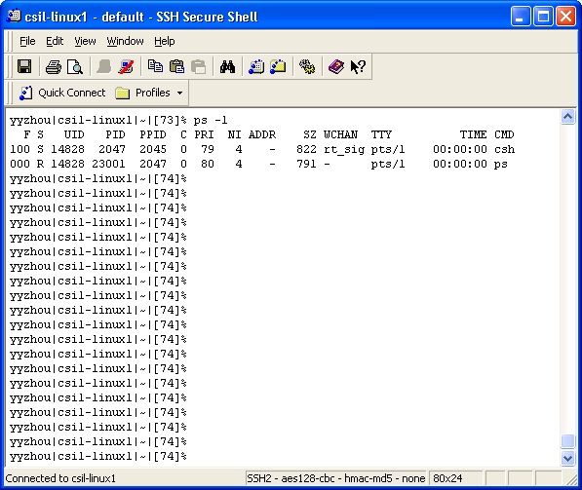
Priority in Unix
Pri=40+nice+cpu/2

Slide 36
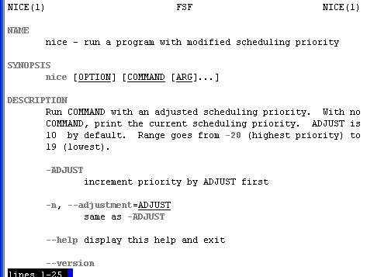
Be “nice” in Unix
Nobody wants to

Slide 37
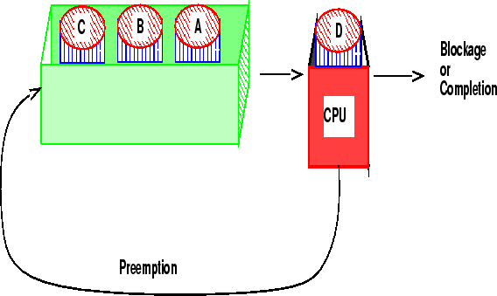
Round-robin
One of the oldest, simplest, most commonly used scheduling algorithm
Select process/thread from ready queue in a round-robin fashion (take turns)
Problem:
Do not consider priority
Context switch overhead

Slide 38
Round-robin: Example
Process | Duration | Order | Arrival Time
P1 | 3 | 1 | 0
P2 | 4 | 2 | 0
P3 | 3 | 3 | 0
Suppose time quantum is: 1 unit, P1, P2 & P3 never block
P1
P2
P3
P1
P2
P3
P1
P2
P3
P2
0
10
P1 waiting time: 4
P2 waiting time: 6
P3 waiting time: 6
The average waiting time (AWT): (4+6+6)/3 = 5.33

Slide 39
Time Quantum
Time slice too large
FIFO behavior
Poor response time
Time slice too small
Too many context switches (overheads)
Inefficient CPU utilization
Heuristic: 70-80% of jobs block within time-slice
Typical time-slice 10 to 100 ms
Time spent in system depends on size of job.

Slide 40
Multi-Queue Scheduling
Hybrid between priority and round-robin
Processes assigned to one queue permanently
Scheduling between queues
Fixed Priorities
% CPU spent on queue
Example
System processes
Interactive programs
Background Processes
Student Processes
Address the starvation and infinite blocking problems

Slide 41
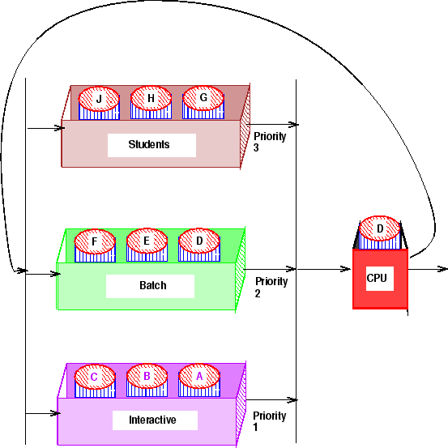
Multi-Queue Scheduling: Example
20%
30%
50%

Slide 42
A Variation: Multi-level Feedback Algorithm
Multi-Level Queue with priorities
Processes move between queues
Each queue represents jobs with similar CPU usage
Jobs in a given queue are executed with a given time-slice
Rational:
Once an I/O process completes an I/O request, it should have higher CPU priority.

Slide 43
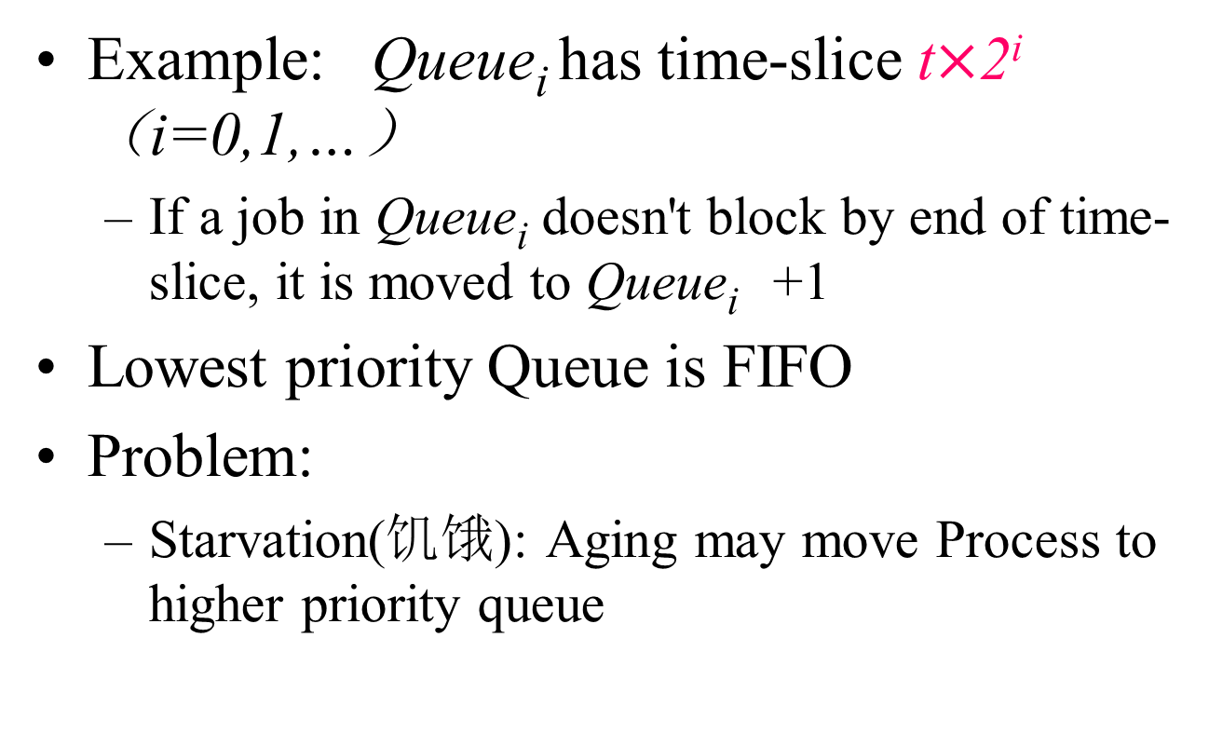
Multi-level Feedback Algorithm (Details)

Slide 44
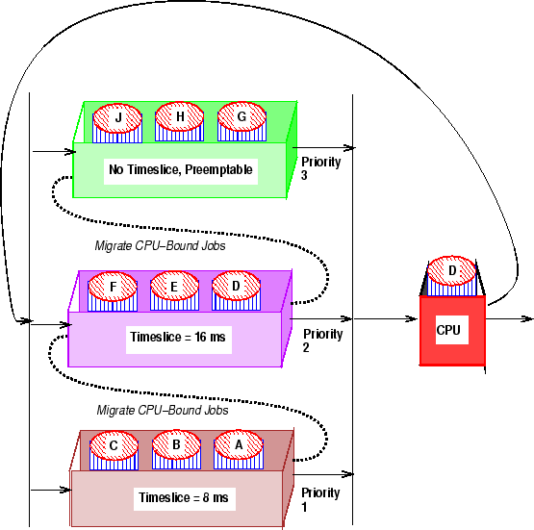
Multi-level Feedback Algorithm: Example

Slide 45
Guaranteed Scheduling保证调度 (QoS)
Make real promises（承诺） to the users about performance and then live up to them
Example:
with n processes running, the scheduler makes sure that each one gets 1/n of the CPU cycles.
Scheduling:
compute the ratio of actual CPU time consumed to CPU time entitled(计算真正获得的CPU时间与应获得的CPU时间的比例)
Select the one with the lowest ratio
Can it lead to starvation?

Slide 46
Lottery Scheduling(彩票调度 --保证调度的一种实现)
More commonly used
Probability-based:
Give processes lottery tickets. At scheduling time, a lottery ticket is chosen at random, and the process holding that ticket gets that resource.
Give more tickets for higher priority processes
Advantages:
Simple
Highly responsive
Can support cooperation between processes
Easy to support priority and proportion(均衡) requirement

Slide 47
Fair-Share Scheduling(公平分享调度)
Is Round-robin fair?
Yes, it is (from process point of view)
No, it may be not (from user point view)
User-based fair share scheduling
Each user gets fair share
Example:
Alice has 4 processes: A1, A2, A3, A4
Bob has 1 process: B1
Then A1, A2, A3, A4 are entitled only to 50% CPU, while B1 alone is entitled to 50%

Slide 48
Multi-Processor Scheduling: Load Sharing
Decides
Which process to run?
How long does it run
Where to run it?
(CPU (horsepower))
I want to ride it
…
Process 1
Process 2
Process n

Slide 49
Multi-Processor Scheduling Choices（调度是二维的：决定哪个线程、哪个CPU）
Self-Scheduled
Each CPU dispatches a job from the ready queue
Master-Slave
One CPU schedules the other CPUs
Asymmetric (非对称)
One CPU runs the kernel and the others runs the user applications
One CPU handles network and the other handles applications

Slide 50
Gang Scheduling（群调度） for Multi-Processors
A collection of processes belonging to one job
All the processes are running at the same time
If one process is preempted, all the processes of the gang are preempted.
Helps to eliminate the time of a process spends waiting for other processes in its parallel computation.

Slide 51
Why Gang Scheduling?
Process 1
Process 2
Switched off
What’s the point of scheduling this process?
Send Data
Receive Data

Slide 52
Priority Inversion and Inheritance
Priority inversion
When a higher priority process needs to read or modify kernel data that are currently being accessed by a lower priority process.
The higher priority process must wait!
But the lower priority cannot proceed quickly due to scheduling.
Solution: priority inheritance
When a lower-priority process accesses a resource, it inherits high-priority until it is done with the resource in question. And then its priority reverses to its natural value.

Slide 53
Scheduling in Real-Time Systems
硬实时(满足绝对截止时间)、软实时(偶尔错失截止时间)
Schedulable real-time system
Given
m periodic events（m 个周期事件）
event i occurs within period P_{i} and requires C_{i} seconds (事件i以周期Pi发生,并需要Ci秒CPU时间处理一个事件)
Then the load can only be handled（可以处理负载的条件） if
满足该条件的实时系统称为可调度的。
调度算法可以是静态或动态的。

Slide 54
Policy versus Mechanism（策略与机制）
Separate what is allowed to be done with how it is done
a process knows which of its children threads are important and need priority
Scheduling algorithm parameterized
mechanism in the kernel
Parameters filled in by user processes
policy set by user process

Slide 55
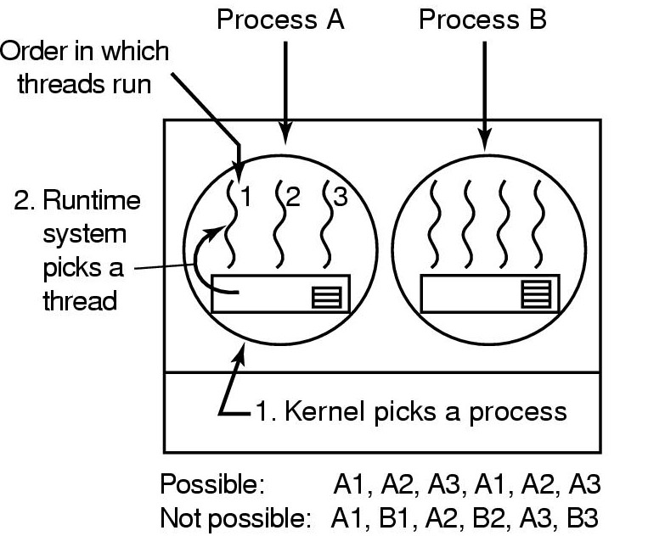
User-level Thread Scheduling
Possible Scheduling
50-msec process quantum
run 5 msec/CPU burst

Slide 56
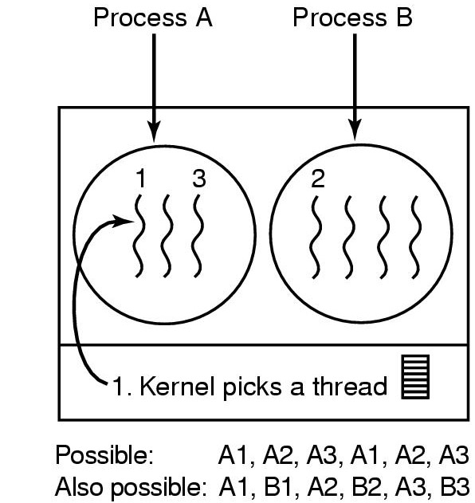
Kernel-level Thread Scheduling
Possible scheduling
50-msec process quantum
threads run 5 msec/CPU burst

Slide 57
Thread Scheduling Examples
Solaris 2
priority-based process scheduling with four scheduling classes: real-time, system, time sharing, interactive.
each process starts with one LWP and generates new LWPs as needed.
A set of priorities within each class.
The scheduler converts the class-specific priorities into global priorities and selects to run the thread with the highest global priority. The thread runs until (1) it blocks, (2) it uses its time slice, or (3) it is preempted by a higher priority threads.
JVM
schedules threads using a preemptive, priority-based scheduling algorithm.
schedules the ``runnable'' thread with the highest priority. If two threads have the same priority, JVM applies FIFO.
schedules a thread to run if (1) other thread exits the ``runnable state'' due to block(), exit(), suspend() or stop() methods; (2) a thread with higher priority enters the ``runnable''state.

Slide 58
Summary
What is scheduling
Scheduling objectives
CPU Scheduling
Batch systems
First Come First Serve (FCFS) -Short Job First
Shortest remaining Time next
Interactive Systems
Round Robin -Priority Scheduling
Multi Queue & Multi-level Feedback
Shortest process time -Guaranteed Scheduling
Lottery Scheduling -Fair Sharing Scheduling
Real-time systems
Policy versus Mechanism
Thread Scheduling

Slide 59
Reminder
Next lecture: Synchronization (chapter 2.3 & 2.5)
Homework P100: 43,44,45,49,50

